Slide 1


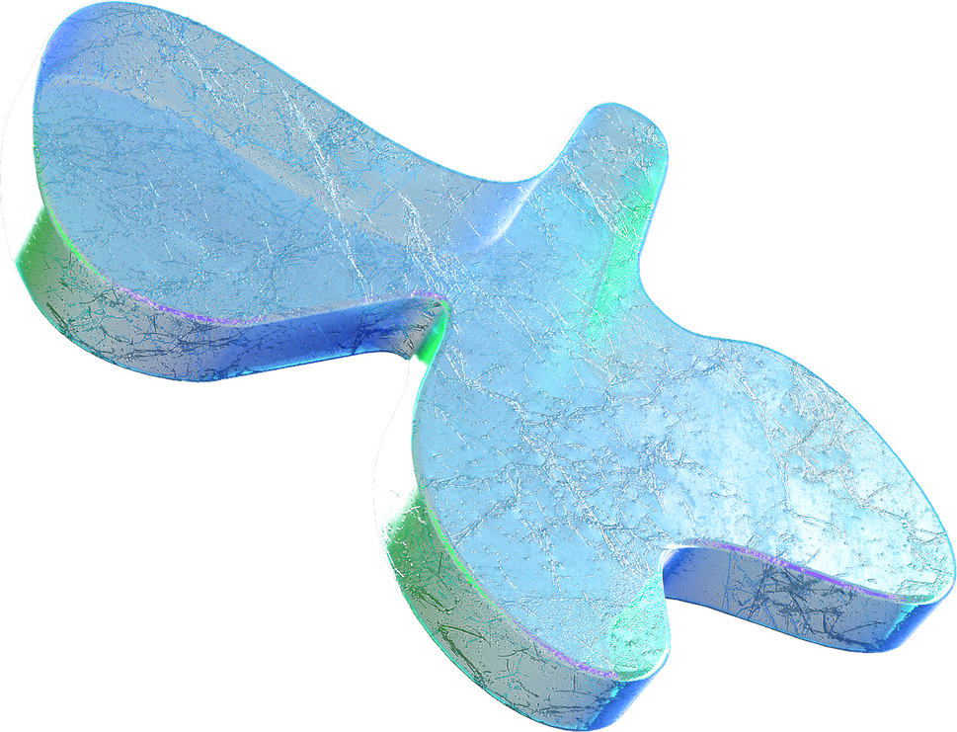
Machine Learning
Day 3

Slide 2
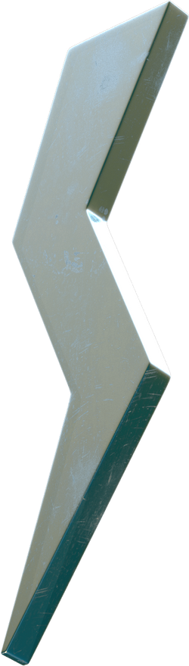
What is gradient descent?
What is backpropagation?
How to load a dataset in PyTorch?
Training a simple neural network
Inferences
Agenda
What you’ll know.

Slide 3

What is gradient descent?
Gradient descent is an optimization algorithm used in machine learning to minimize the cost function of the model.

Slide 4
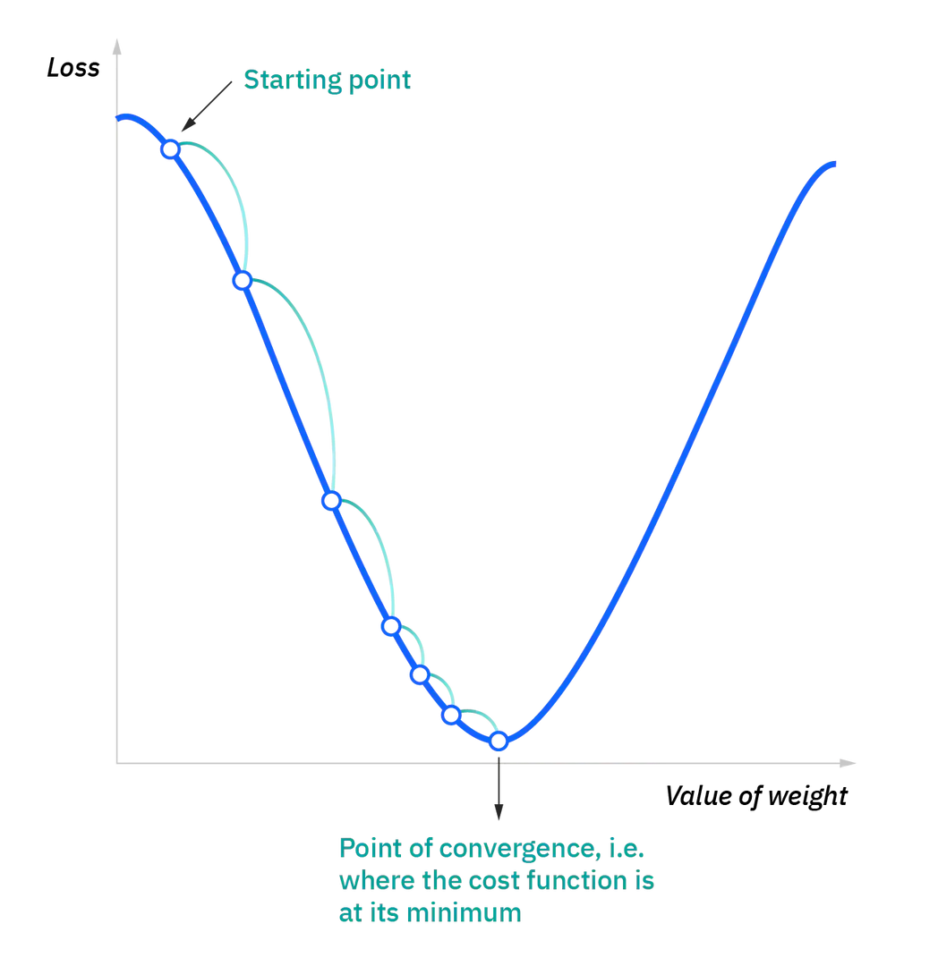

Slide 5
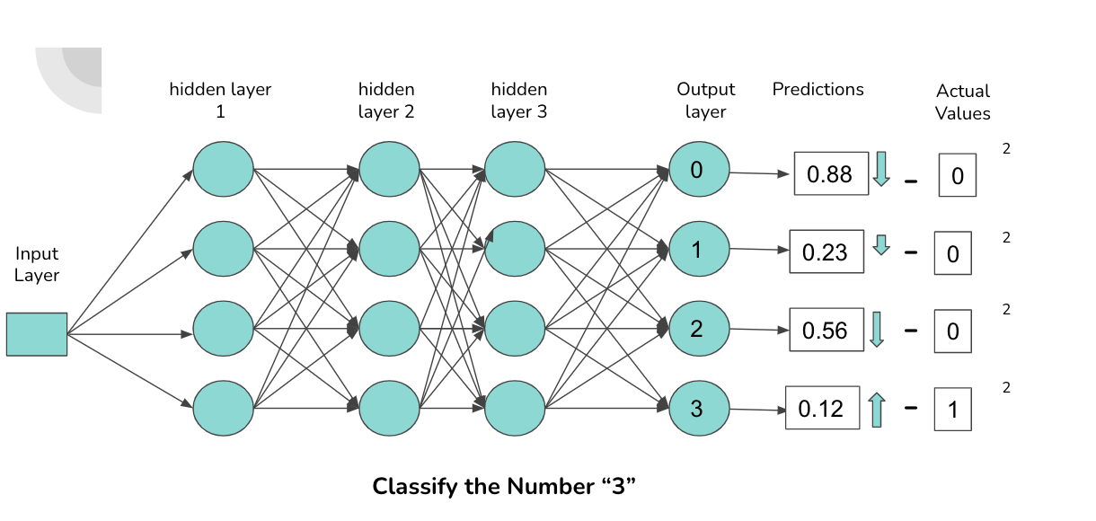

Slide 6
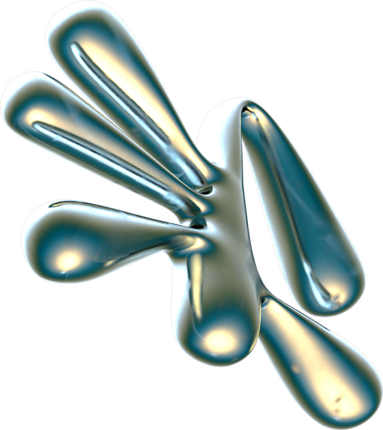
Loading a dataset in PyTorch

Slide 7
Dataset class
DataLoader class
Deals with the data fetching, preprocessing and gets the data ready in a form the neural network requires for training.
Deals with efficient loading of data in the form of batches for feeding into the models, enabling easy access to the data samples.

Slide 8
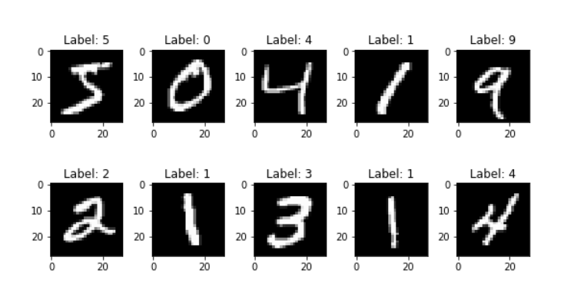
PyTorch MNIST Dataset

Slide 9
Simple Neural Network
keywords
LOSS FUNCTION |  | OPTIMIZER FUNCTION |  | LEARNING RATE
It quantifies how far off our predictions are from the actual targets. Mean Squared Error (MSE) Example: In a digit recognition task,it tells us how far off our network's guess (e.g., "5") is from the true label ("5"). |  | The optimizer function is responsible for adjusting the (weights and biases) of the model in order to minimize the loss. Stochastic Gradient Descent (SGD) |  | It is a hyperparameter that determines the size of the steps the optimizer takes . A higher learning rate allows the network to learn quickly, but it may skip over the best solution. A lower learning rate makes learning more precise but slower

Slide 10
Thank you :)
We hope you learned something new.

